Slide 1
Internet Browsing Vulnerabilities and Security
ECE4112 Final Lab
Ye Yan
Frank Park
Scott Kim
Neil Joshi

Slide 2
Introduction
Exploits
  CSS
  JavaScript
  JPEG Buffer exploit
Web Servers
  Apache
  IIS (Internet Information Services)
Web Browsers
  Internet Explorer
  Firefox

Slide 3
CSS Exploits: Overview
Cross-Site Scripting
Caused by the failure of server application to validate user input before returning it to the client
“Cross-Site” refers to the restriction of client application. For example, the JavaScript on one website only has access to the cookie set by that site, it cannot "cross-site" and access the cookie set by another website.
But if bad guys can inject code onto another website, then they get access to the documents associated with that site! (eg. cookie)

Slide 4
CSS Exploits: Our Lab
In our lab, two files, vulnerable.html and vulnerable.php
vulnerable.html has a form that submits data using GET. vulnerable.php gets the data and simply echoes back to the user.
Clearly vulnerable because malicious code can be entered and echoed back!
Since we're using GET, specially formatted URLs bypass the form completely, enabling bad guys to mass-mail out URLs with malicious code embedded in them.

Slide 5
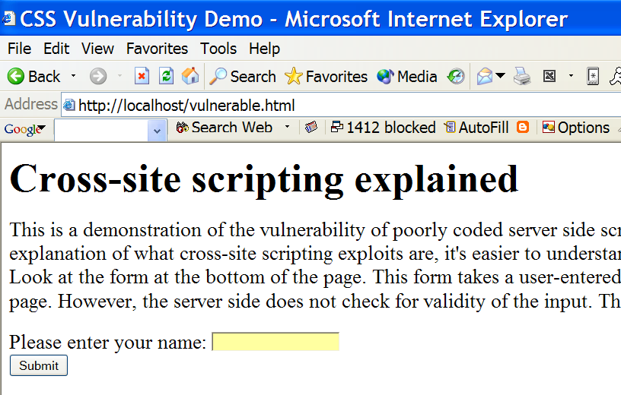
CSS Exploits: Example

Slide 6
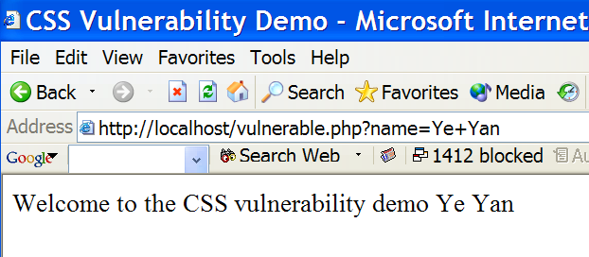
CSS Exploits: Example

Slide 7
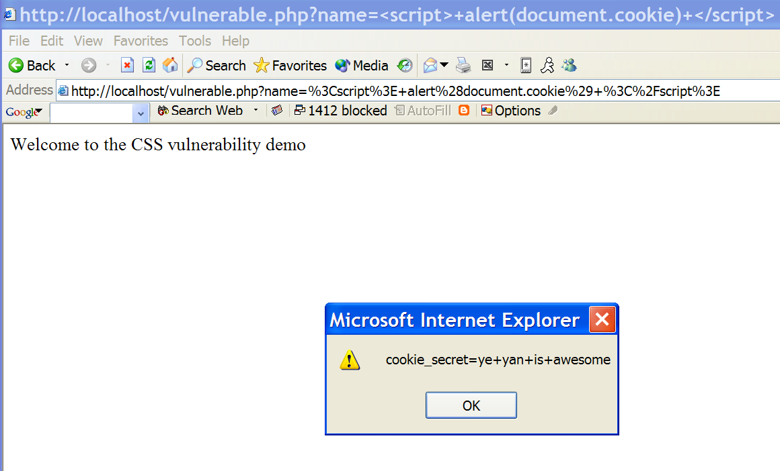
CSS Exploits: Example

Slide 8
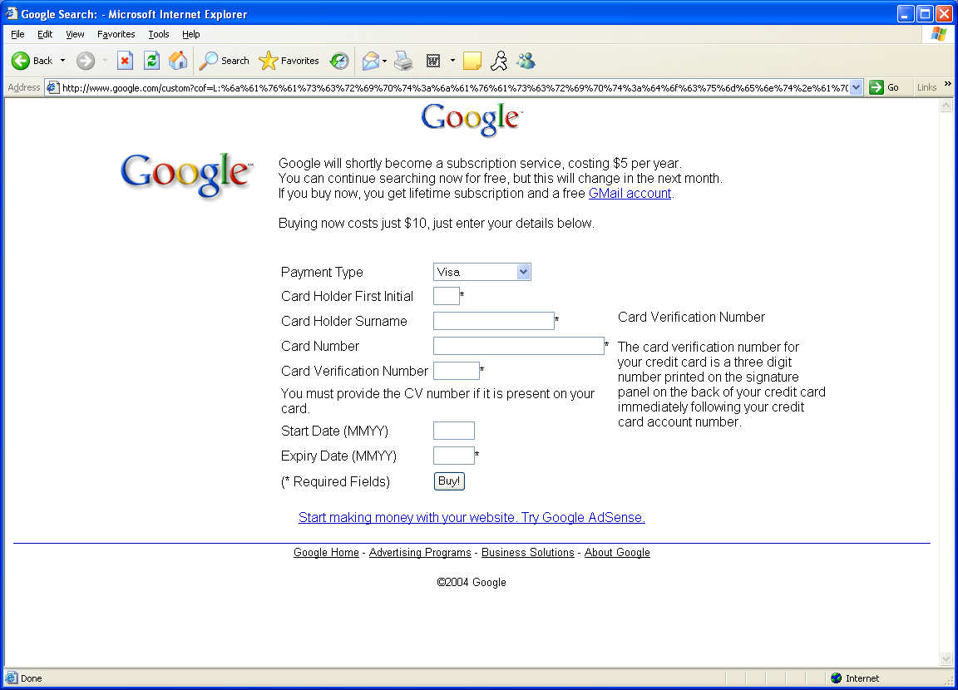
CSS Exploits: Real World Example

Slide 9
CSS Exploits: Prevention
Use POST instead of GET for form data transfer
On client side, filter user input (not very effective)
On server side, filter out special characters such as < \ / % &, etc.

Slide 10
JavaScript Exploits
Background
Potential Threats
Known Security Flaws
How to protect
In this lab…

Slide 11
JavaScript Exploits: Background
JavaScript is a scripting language that resembles Java, but has no ties to it
The purpose of JavaScript is to make websites more interactive
The script is executed by the Web browser when the document is loaded
Example of JavaScript is rollover images

Slide 12
JavaScript: Potential Threats
In recent years, vulnerabilities have been detected in web browsers that use JavaScript
These scripts can potentially load deadly viruses and Trojans on a user’s computer

Slide 13
JavaScript: Known Security Flaws
The "Cuartango" and "Son of Cuartango" Holes (November 1998)
The Netscape "Cache Browsing Bug" (October 1998)
Ability to Intercept the User's E-Mail Address and Other Preferences (February 1998)

Slide 14
Java Script: Known Security Flaws
More Recently
  JavaScript Exception Exploit (JS.Exception.Exploit) Virus/Worm
    Allows applets to run arbitrary code on unpatched machines
  JavaScript IFRAME Exploits
    Allows malicious code to be run inside an <IFRAME> or <FRAME> tag

Slide 15
JavaScript: Protection
What is the best way to protect?
  Turn off ActiveX controls and JavaScript in browser
What is the downside to this?
  Removes ability to have interactive web experience

Slide 16
JavaScript: In this lab…
Explore the syntax and basic function of a script
Create a script which exploits a vulnerability in Internet Explorer 6.0
The exploit bypasses security protocols that warn users of potentially harmful viruses

Slide 17
JPEG Attack Vulnerability
Vulnerability was disclosed by Microsoft in September 2004
  No attacks were reported prior to this announcement
Takes advantage of the flaw in how Microsoft applications processes JPEG files
Malicious JPEG files are capable of triggering buffer overflow in a common Windows component (GDI+)
JPEG files are typically viewed "as a benign and trusted file format... as such it is possible to cause image files to be viewed with minimal user-interaction through several applications including many email clients such as Outlook and Outlook Express,"

Slide 18
Capability of this Attack
Bind a shell to a port
  Allows others to access the shell of the machine
Reverse connect a shell to a port
  Can reverse connect to other machines
Download a file from an HTTP Server
  Can grab all files that HTTP server contains
Add a new administrator user
  Can make new root account

Slide 19
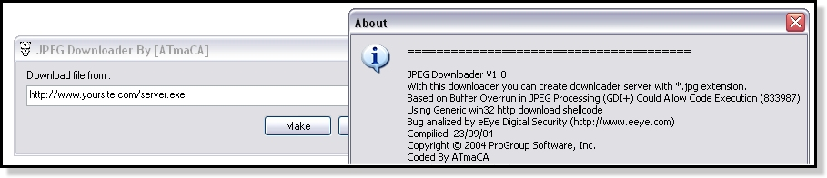
ATmaCA Downloader

Slide 20
ATmaCA Downloader
Has Alias name of “TrojanDownloader.Win32.Atmader.10”
The Trojan dropped by this hack tool attempts to download and execute files from a URL, which a malicious user inputs in the dialogue box
This hack tool also drops the file MYPICTURE.JPG in the current folder
Creates a downloader server with JPG extension

Slide 21
“Save Picture As”
Vulnerability found in some Internet Explorer versions
When “Save Picture As” command is executed, IE strips the extension if multiple file extensions exist
This can be exploited by a malicious web site to cause a valid image with malicious, embedded script code to be saved with an arbitrary file extension
For example, if you have a file name “exploit.jpg.hta”, this will be shown as “exploit.jpg” on the explorer (assuming the windows option to hide the known extension is on)
If a user decides to open what seems to be a jpg file, it will open a .hta file (HTML application file) that may contain malicious scripts

Slide 22
Web Browsers
Internet Explorer has a much higher user base than its competitors
More users = More victims for attacks
Many malicious scripts developed for IE
Two solutions to problem:
  Repair
  Replace

Slide 23
Web Browsers: Repair
Changing settings on IE
  Tools → Internet Options
Adding trusted programs to combat unwanted effects to be placed on a computer
  IE-SPYAD (used in this lab)
  Browser Hijack Blaster
  Spyware Blaster
Beware of friendly imposters

Slide 24
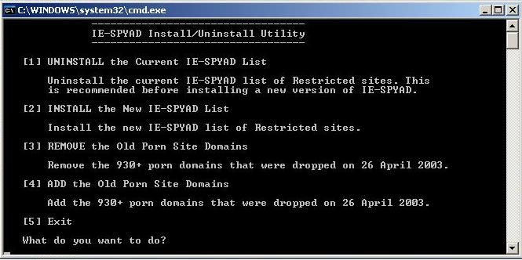
Web Browsers: Repair

Slide 25
Web Browsers: Replace
In this lab, we use Mozilla Firefox
  Run same exploits and show that computer is not affected
Other alternatives include:
  Opera
  Mozilla/Netscape
  Konqueror
  Safari (Mac)

Slide 26
ShieldsUP!! Internet Profiling
Users can find out their own IP address
Free tests
  File Sharing Test
  Common Ports
  All Service Ports
  Specific Port Testing

Slide 27
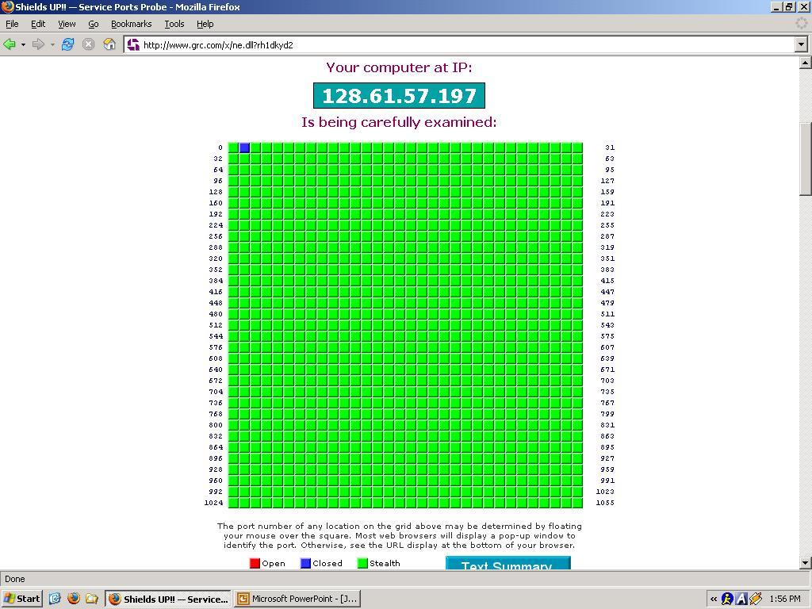
ShieldsUP!! Port Scan

Slide 28
What you will do in the lab
Install Apache and IIS Web Servers
Run exploits on both Internet Explorer and Firefox
  CSS exploit
  Javascript exploits
Analysis of Advanced Attacks
ShieldsUP!! Website – port testing

Slide 29

Questions?

